Slide 1
BASICS OF LETTERING
NEED FOR LETTERING
Lettering is needed for
    Dimensions of parts
    Notes relating to the manufacture of parts
    Descriptive titles.
Shall be
    Highly legible (of handwriting or print) clear enough to read.
    Uniform
    Capable of being done rapidly

Slide 2
CONSIDERATIONS FOR GOOD LETTERING
  General Proportions
    No specific standard for the proportions of letters
    Proportion of width to the height of letters varies.
    Low and extended letters are more legible than high compressed ones.
  The Rule of Stability
    In order to give the appearance of stability, letters as B, E, K, S, X, and Z and the digits 3 and 8 must be drawn smaller at the top than at the bottom.
  Guide Lines
    Always draw light guide lines for both tops and bottoms of letters. A very sharp pencil shall be used for the purpose.

Slide 3
  Styles of Lettering
    No specific standard for the style of lettering
    Styles shall be simple and clear to facilitate the reading of a drawing.
    TIME-CONSUMING LETTERING STYLE
    AN EFFICIENT LETTERING STYLE
    A LIMITED-USE LETTERING STYLE
  Size of Lettering
    Shall be at least 0.125 in (3.00 mm) high
  Aspect Ratio
    The width/height ratio
    No specific standard

Slide 4
THEORY OF DEMINSIONING
PURPOSE OF DIMENSIONING
    To provide exact information on the size and position of each feature of the part for production purposes.
SIZE VS. POSITION DIMENSIONS
    Dimensions can be classified as those for size or position.
    Each feature shall be dimensioned and positioned only once.
    Each feature shall be dimensioned and positioned where its shape is shown.

Slide 5
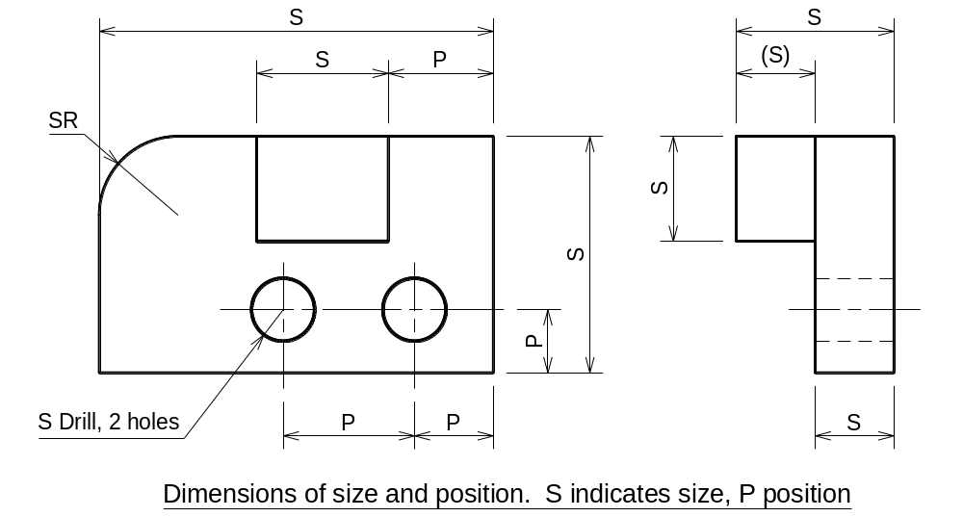

Slide 6
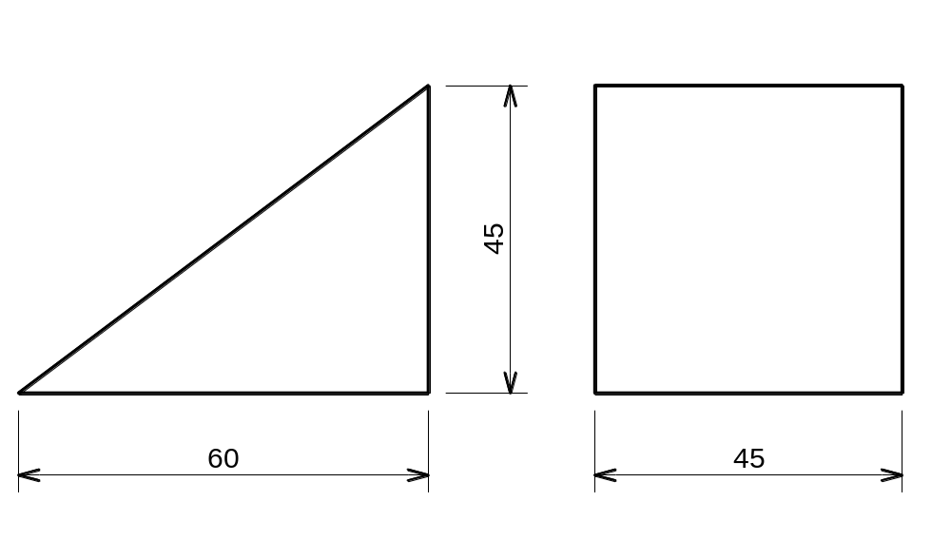
BASIC EXAMPLES OF DIMENSIONS OF SIZE AND POSITION
Each of the geometric shapes making up the object must have its height, width, and depth indicated in the dimensioning.
  Prism
    The most common shape
    Requires all the three dimensions (for base and length)

Slide 7
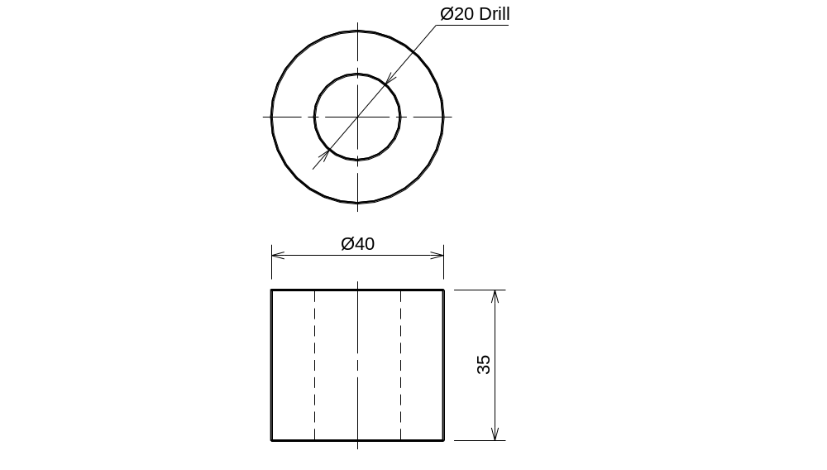
  Cylinder
    The second most common shape
    Requires only two dimensions, diameter and length
    Partial cylinders are dimensioned by radius instead of diameter.

Slide 8
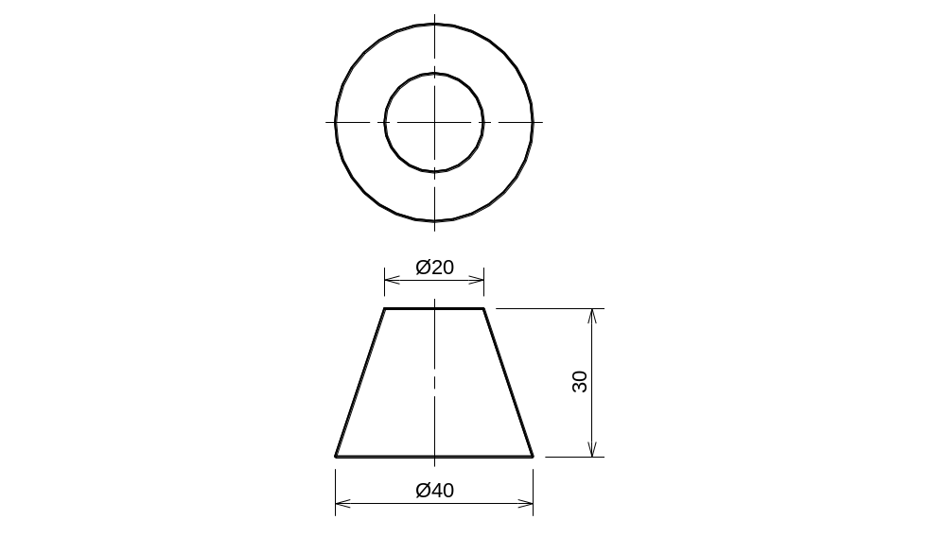
  Cone
    Requires only altitude and base diameter.
    Frustum will require diameters at both ends and the length.

Slide 9
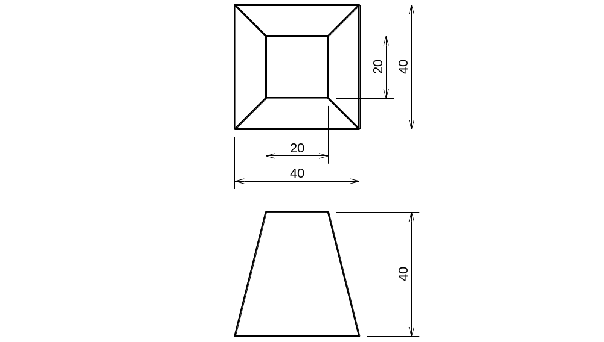
  Pyramid
    Requires the dimensions of base and altitude
    Frustum will require dimensions of both bases and the length.

Slide 10
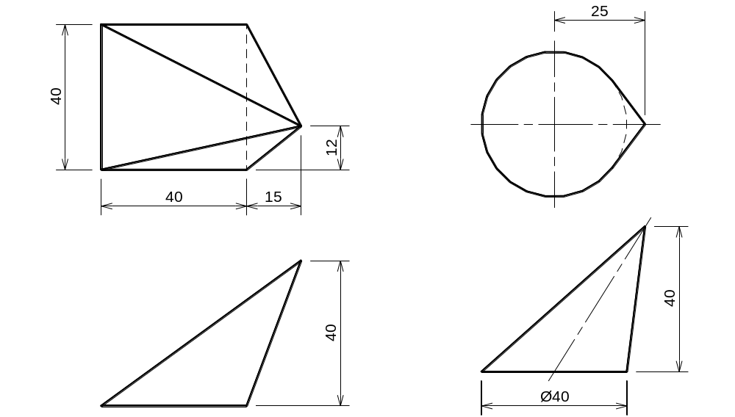
  Oblique Cones and Pyramids
    Dimensioned in the same way as cones and pyramid but with an additional dimension parallel to the base to give the offset of the vertex.

Slide 11
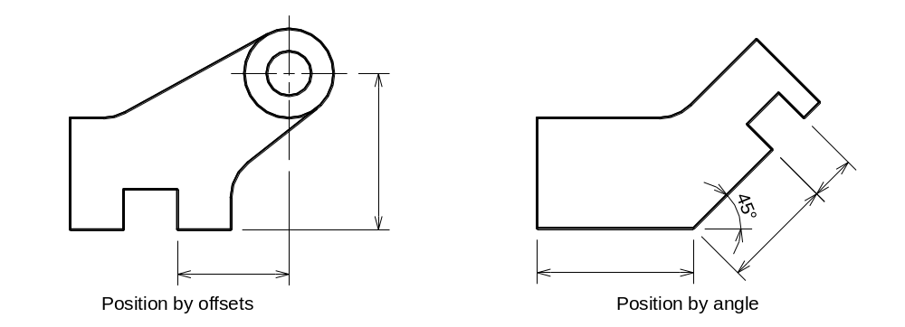
SELECTION OF DIMENSIONS
    More care shall be taken in selecting dimensions of position than selecting dimensions of size.
    Positional dimension usually are given between finished surfaces, centre lines, or a combination
    Rough castings or forgings vary in size. Therefore DO NOT position machined surfaces relative to unfinished surfaces.
    The position of a point or centre by offset dimensions from two center lines or surfaces is preferable to angular dimensions unless the angular dimension is more practical for construction purposes.

Slide 12
THE CONTOUR PRINCIPLE
  One view of a part usually describe the shape of some feature better than other views.
  A feature is best dimensioned in the view showing the shape of the feature.
  Duplicate or unnecessary dimensions shall be avoided. A duplicate dimensioned may go unnoticed if a drawing is revised, creating confusion.
  Unnecessary dimensions can be used only as references but shall be enclosed within parentheses.
  Dimensions are preferred to be placed outside the views.
  Dimensions shall be kept off the cut surfaces of sections.
  Always place a longer dimension line outside a shorter one to avoid crossing dimension lines with the extension lines of other dimensions.

Slide 13
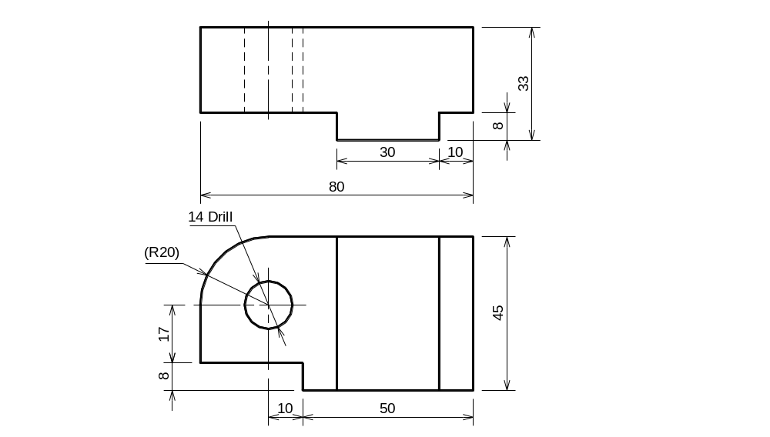
The contour principle

Slide 14
DIMENSIONAL CLARITY USING A DATUM
  Datum points, lines and edges of surfaces of a part are used to establish the position of other features.
  Where positions are specified by dimensions from a datum, different features are always positioned from this datum and not with respect to one another.
  A feature selected as a datum must be clearly identified an readily recognizable. It must also be accessible during manufacture.
  A datum surface on a physical part must be more accurate than the allowable variation on any dimension of position.
  It is necessary to specify the perfection of datum surfaces for flatness, straightness, roundness, etc.

Slide 15
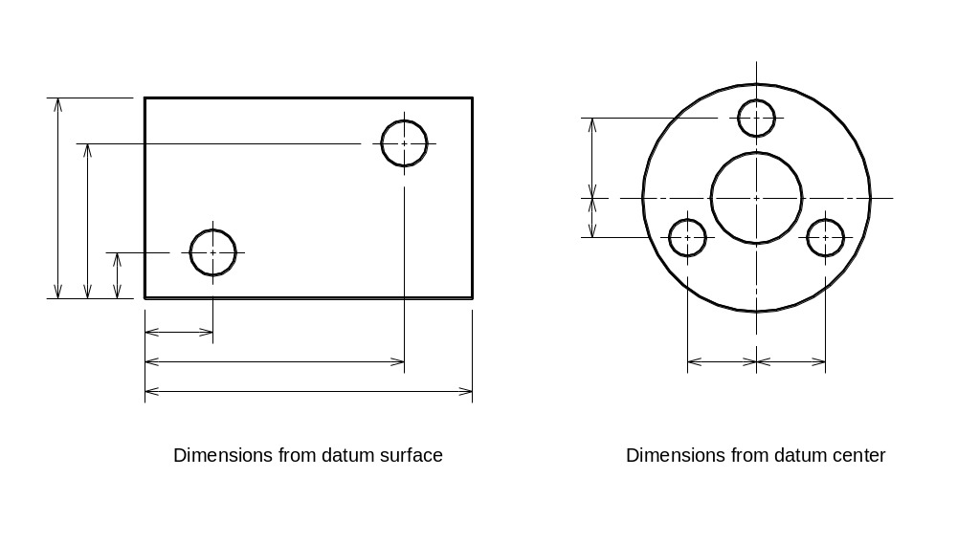

Slide 16
DIMENSIONING TECHNIQUES AND CONVENTIONS
USE OF SCALE
  A part may be drawn to any convenient scale.
  The scale must be indicated in an easily seen area of the working drawing, often in the title block. If a sheet of drawing has more than one scale used, then the scale shall be mentioned next to the relevant view.
  The dimensions placed on the part are always actual size dimensions.

Slide 17
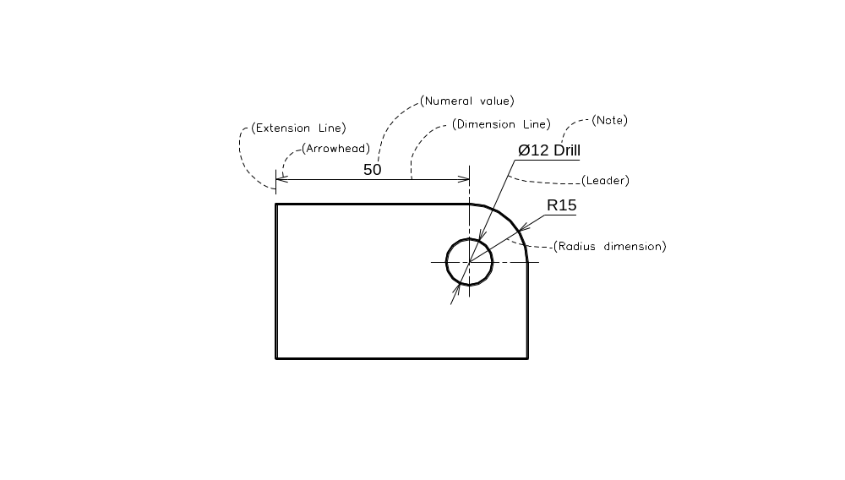
DIMENSIONS AND NOTES
  Distances can be given as either dimensions or notes.
  Specific notes have a leader and shall be placed close to the feature to which they apply.
  General notes do not require a leader and should be grouped together above the title block.

Slide 18
EXTENSION LINES AND LEADERS
  Extension Lines
    Shall not touch the outline of the view. There shall be an offset of about 1.5 to 2 mm from the origin.
    Shall extend 2.5 to 3 mm beyond the last dimension line.
    Dimensions may also terminate at center lines or visible outlines of the view.
    Center lines are extended to serve as extension lines where the distance between centers is to be shown.
    Extension lines for an angular dimension can be used to place linear dimensions.
    Extension shall not be broken where they cross each other or an outline of a view. When space is restricted and extension lines come close to arrowheads, the extension lines may be broken for clarity.
    Where a point is located by extension lines alone, the extension lines should pass through the point.

Slide 19
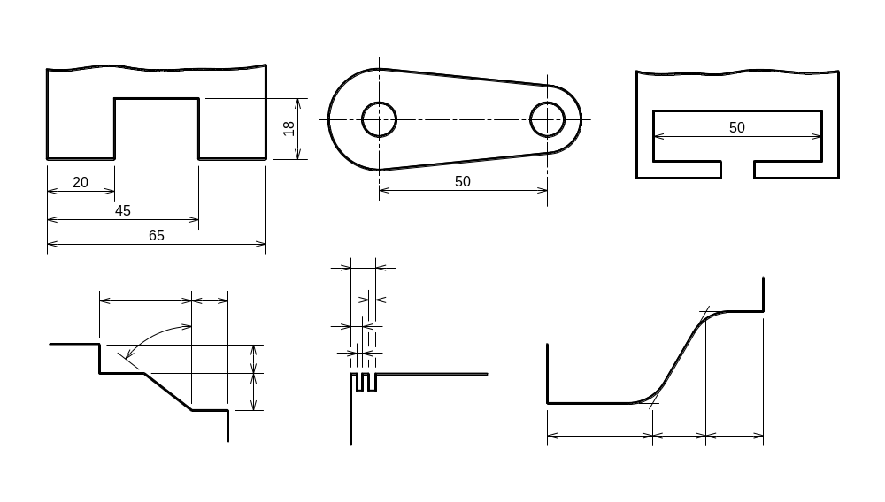

Slide 20
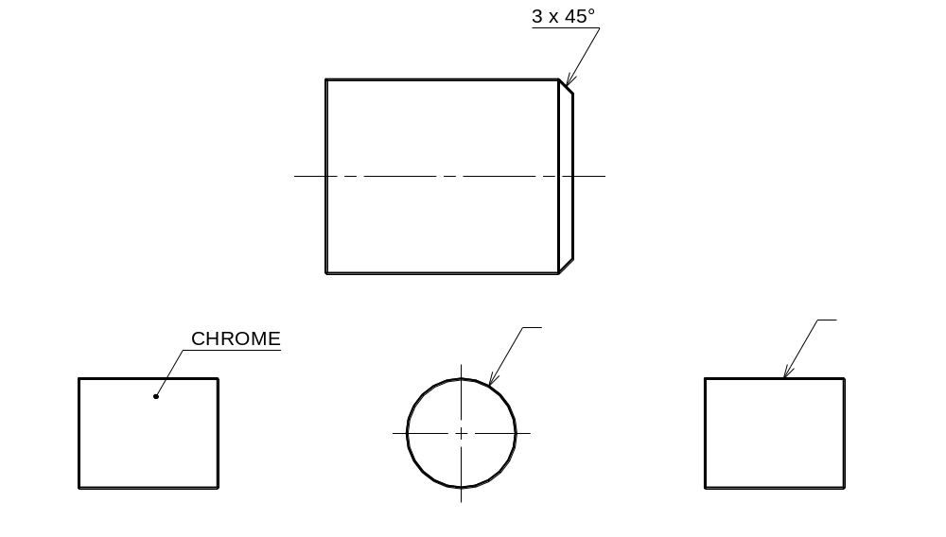
  Leaders
    Leaders are straight (not curved) lines leading from a dimension value or an explanatory note to the feature on the drawing to which the note applies.
    Arrowhead is used at the pointing end of the leader.
    Shall be drawn at an angle to the principal lines of the drawing.
    A dot sometimes may be use for termination of a leader.
    Avoid long leaders or crossing leaders.

Slide 21
LINE WEIGHTS AND ARROWHEADS
  Line weights for the dimension lines and extension lines shall be 0.2 mm to 0.25 mm.
  Arrowheads shall be darker in appearance than the extension lines and dimension lines. Both open 30º and closed filled can be used.
  Arrowheads shall be about 3 mm long and shall have a consistent size and appearance throughout the drawing.
DIMENSION TEXT
  Dimension text shall be about 3 mm high.
  In the BSI and ANSI methods the text is placed horizontal between the dimension line.
  In the ISO methods the text is always placed above the dimension line. The text must be aligned to the dimension line if it is written between the extension lines. If however, it is written outside, then it shall be horizontal.
  In the BSI and ANSI methods, if arrows are placed outside, then dimension line shall not be drawn between the extension lines.
  In the ISO methods, the dimension line shall always be drawn.

Slide 22
